Slide 1
Cochrane Crowd and TaskExchange: getting involved in producing health evidence

Slide 2
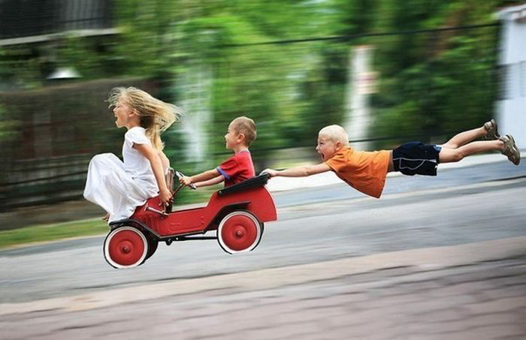
Welcome!
40 minutes of fun ahead!

Slide 3
TaskExchange: what is it?
Cochrane Crowd: what is it?
How can you show trainees?
Q&A

Slide 4
Both platforms are about providing better opportunities for people to get involved and better harness the skills of those
already involved
People are our greatest asset

Slide 5
What is TaskExchange?
An online platform that connects members of the evidence community who want help with their work with people who have the
skills and time to help
taskexchange.cochrane.org

Slide 6
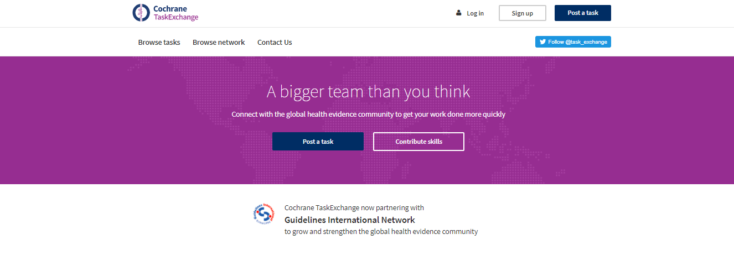
TaskExchange

Slide 7
TaskExchange
Brings people together to get health evidence work done more quickly
The place to go if you need help, or want to help out, with a review, guideline or other evidence work
Provides:
Opportunities for meaningful contributions by newcomers and experts alike
A way to overcome time & skill challenges for current community members

Slide 8
Get help!

Slide 9
Help out!

Slide 10
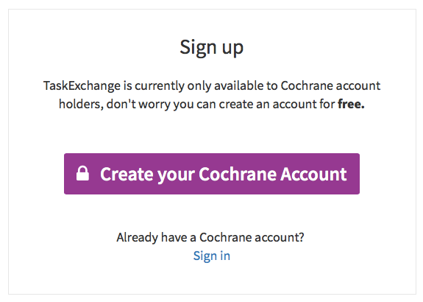
Log in

Slide 11
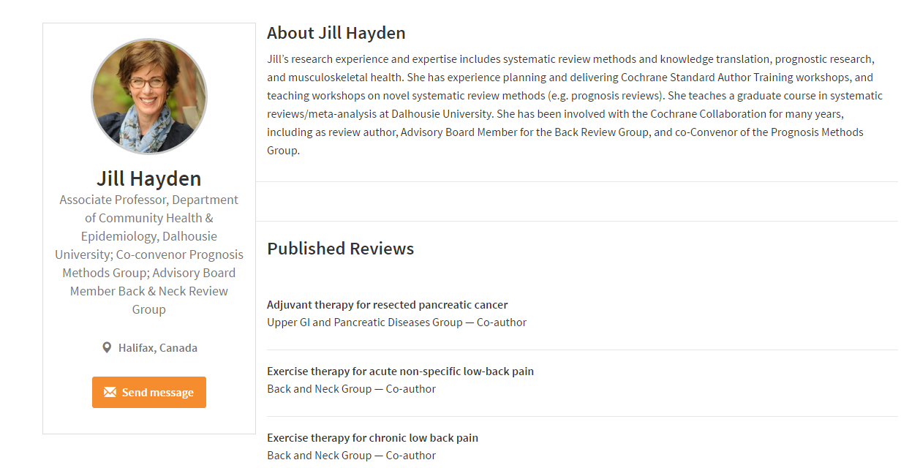
Create your profile

Slide 12
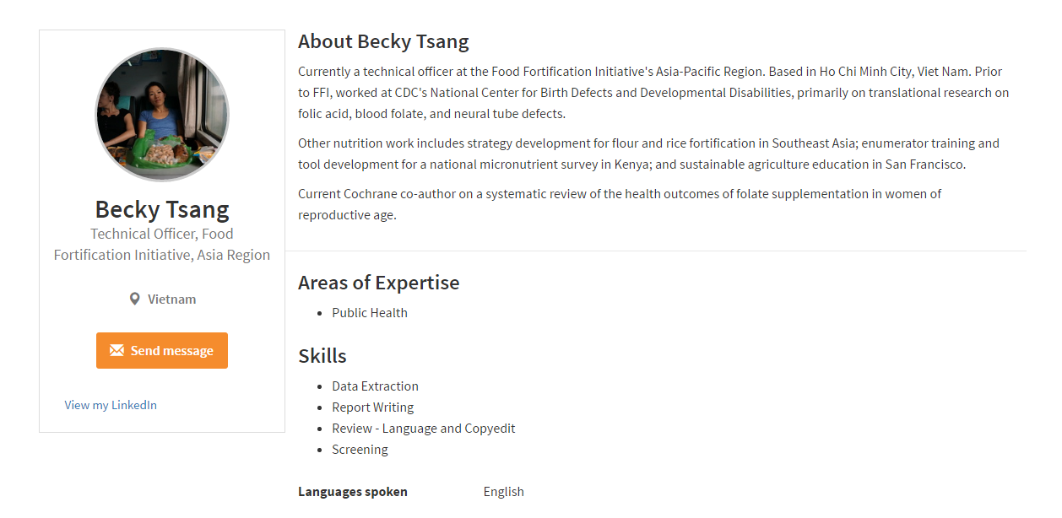
Create your profile

Slide 13
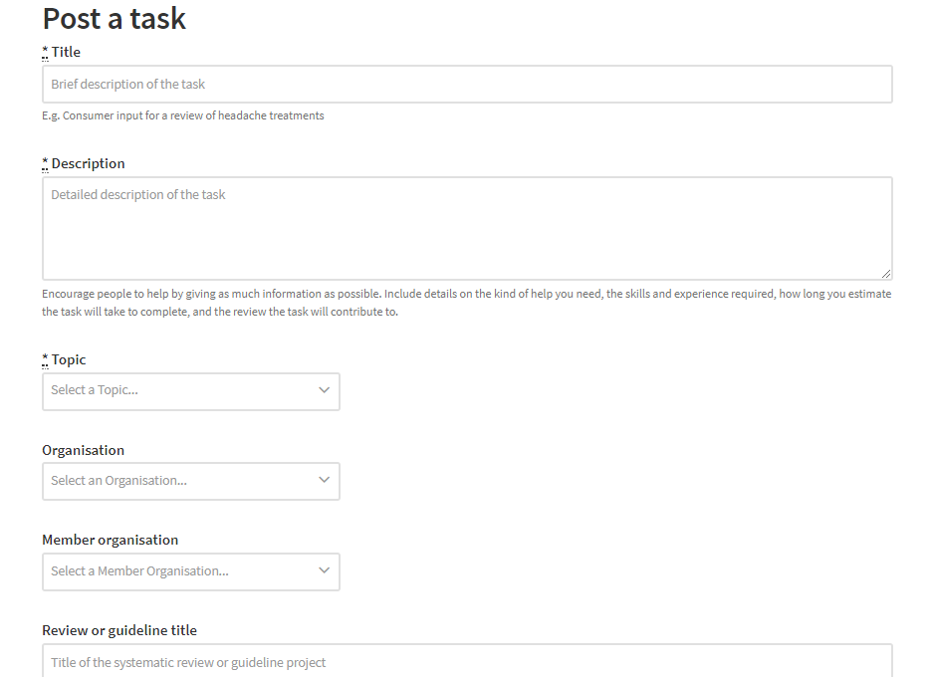
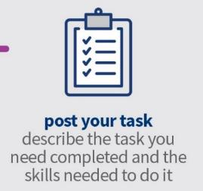
Post your task

Slide 14
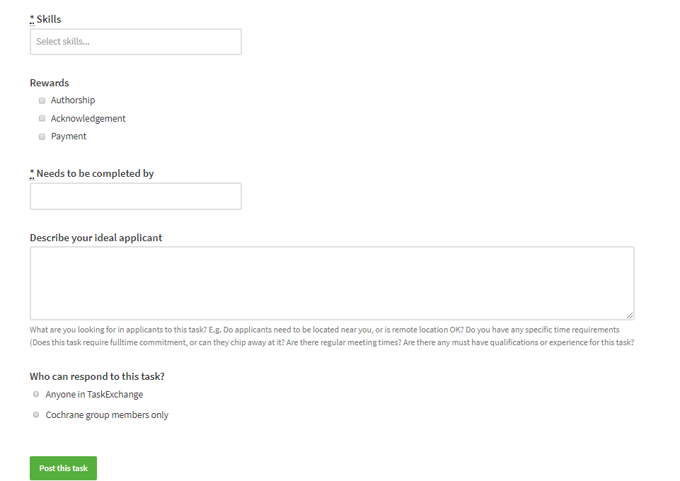
Post your task

Slide 15
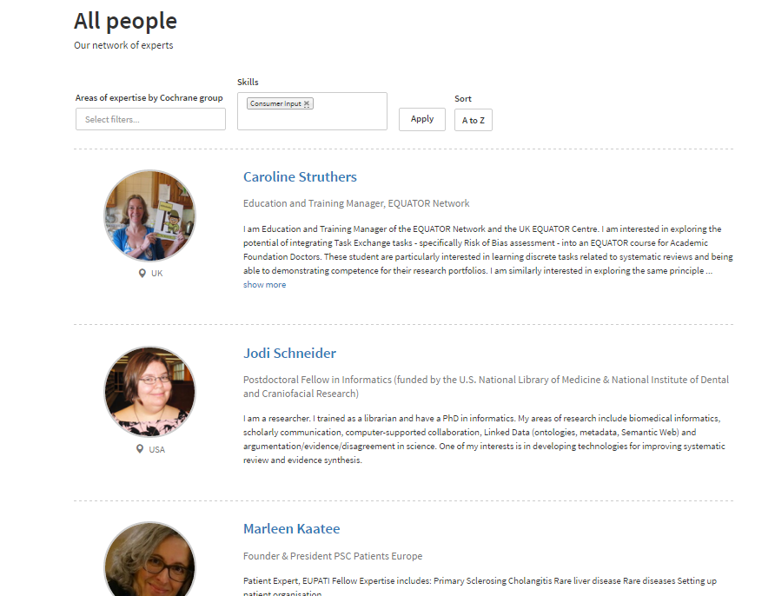
Browse our list of experts

Slide 16
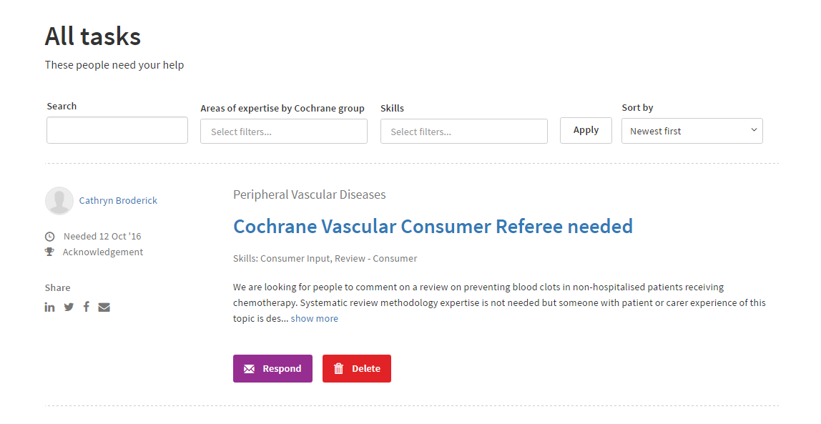
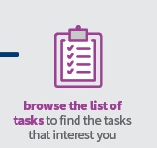
Browse the list of tasks

Slide 17
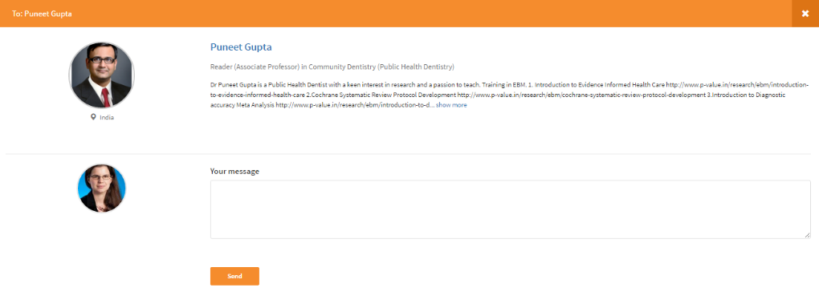
Get in contact

Slide 18
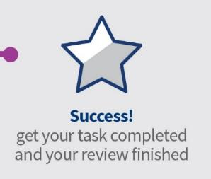
Get your task completed

Slide 19
New Feature!! Say thanks

Slide 20
Try it for yourself: taskexchange.cochrane.org

Slide 21
Cochrane Crowd
crowd.cochrane.org | @cochrane_crowd

Slide 22
What is Cochrane Crowd?
A platform that hosts tasks that help produce high quality health evidence
using crowdsourcing
crowd.cochrane.org

Slide 23
Crowdsourcing
The practice of obtaining needed services, ideas, or content by soliciting contributions from a large group of people and especially from the online community
rather than from traditional employees or suppliers
[Merriam-Webster]

Slide 24
Crowdsourcing
Crowd creation
e.g. Threadless
4 types of crowdsourcing:
crowd creation

Slide 25
Crowdsourcing
Crowd creation
e.g. Threadless
Crowd wisdom
e.g. The SIM exchange
4 types of crowdsourcing:
crowd creation, crowd wisdom

Slide 26
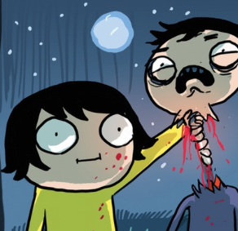
Crowdsourcing
Crowd creation
e.g. Threadless
Crowd wisdom
e.g. The SIM exchange
Crowd funding
e.g. Kickstarter
Jelly Vampire
(not suitable for kids)
4 types of crowdsourcing:
crowd creation, crowd wisdom, crowd funding

Slide 27
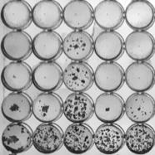
Crowdsourcing
Crowd creation
e.g. Threadless
Crowd voting
e.g. Zooniverse
Crowd wisdom
e.g. The SIM exchange
Crowd funding
e.g. Kickstarter
Jelly Vampire
(not suitable for kids)
4 types of crowdsourcing:
crowd creation, crowd wisdom, crowd funding, crowd voting

Slide 28
Crowdsourcing
Crowd voting
“human intelligence tasking”

Slide 29
Crowdsourcing
Large data sets
Crowd voting
“human intelligence tasking”

Slide 30
Crowdsourcing
Large data sets
Crowd voting
“human intelligence tasking”
Multiple classifications

Slide 31
Crowdsourcing
Large data sets
Crowd voting
“human intelligence tasking”
Multiple classifications
Three key ingredients
Agreement algorithm

Slide 32
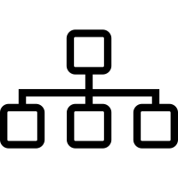
The tasks
Reviews are complex but they are made up of a number of steps or processes

Slide 33
The tasks
Is it a randomised trial?
Is it a diagnostic study?
What is the PICO?
Where is the participant characteristics table?

Slide 34
The microtasks
Available
Planned or in beta
Identifying
Describing
YES
P
I
C
O
Is it an RCT?
YES
P
E
C
O
Is it a DTA?

Slide 35
Headline metrics
1,640,693
Individual classifications
480,000
Records collectively screened
35,000+
Randomised trials found
8,161
People have signed up
Data as of 05 Feb 2018

Slide 36
Contributor experience
Create pathways to better enable individuals, communities and organizations to
access and contribute to relevant tasks

Slide 37
Focus on health topics of interest
Individuals, communities and organizations can now
access Cochrane Crowd at the healthcare condition level
Through unique urls:
e.g. crowd.cochrane.org/neonatal
Access to tasks in areas of interest to people

Slide 38
Milestone badges: moving from beginner to expert,
unlocking new, more challenging tasks as you go
Beginner
Expert

Slide 39
Micro-training modules
Treatments can harm
Anecdotes are unreliable
Expert opinion alone is not enough
The role of comparison
Comparing like with like
The role of blinding
Size matters

Slide 40
What’s next: “Screen For Me”
Send my search results to the Crowd
Can Cochrane Crowd help Cochrane review author teams with their search results?

Slide 41
Why so good for trainees?
Both are a great way to learn some new skills
Both enable you to contribute meaningfully to Cochrane and EBHC
Both record your work and progress
Both offer rewards

Slide 42
How to tell others about TaskExchange and Cochrane Crowd?
We have materials you can share
We have slides you can have
We can help you set up an interactive activity
http://community.cochrane.org/tools/project-coordination-and-support/project-transform

Slide 43
Examples of interactive activities
Creating a profile on TaskExchange (5-10 minutes)
Going through the ‘taster’ area of Cochrane Crowd (5-10 minutes)
Setting up a live ‘challenge’ in Cochrane Crowd (20 minutes +)
Let’s do one of these!

Slide 44
Cochrane Crowd: crowd.cochrane.org
TaskExchange: taskexchange.cochrane.org

Slide 45
Thank you!

