Slide 1
Evidence-based medicine: an introduction
Lynda Ware & Selena Ryan-Vig

Slide 2
Notes:
Cochrane is a not-for-profit organization with contributors from more than 130 countries working together to produce credible, accessible health information that is free from commercial sponsorship and other conflicts of interest.
Cochrane exists so healthcare decisions get better.
Cochrane aims to achieve this by producing reviews that summarize the best available evidence generated through research to inform decisions about health.

Slide 3
Notes:
What is evidence based medicine?
When did evidence based medicine begin?
Why is it important?
How is evidence brought together?
Who needs to know about it?
Where you can find reliable, evidence-based information?

Slide 4
What?

Slide 5
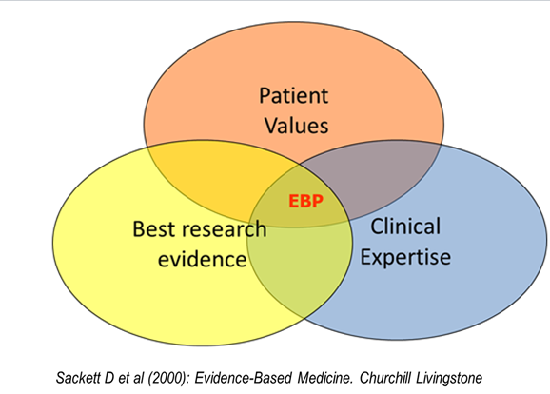
EBM
“Evidence-based medicine is the integration of best research evidence with clinical expertise and patient values.”

Slide 6
When?

Slide 7
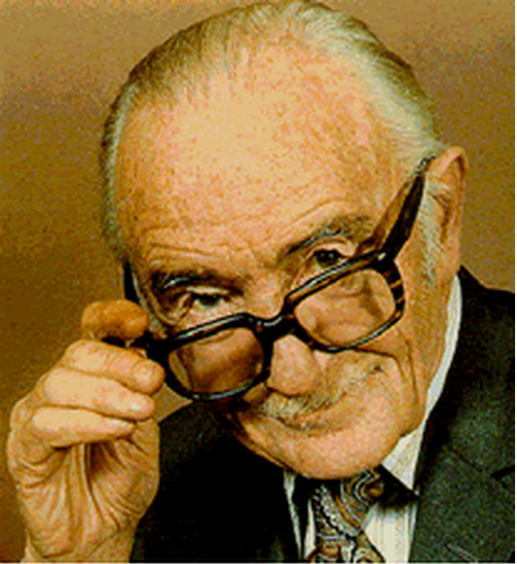
Archie Cochrane
https://www.ted.com/talks/tim_harford

Slide 8
Why?

Slide 9
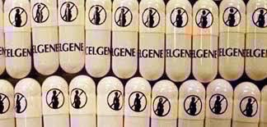
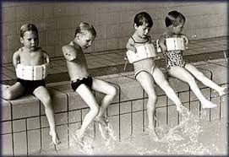
Thalidomide Tragedy
Notes:
‘One of the darkest episodes in pharmaceutical research’.
Discovered 1953. Licenced in Germany for OTC use in 1956. Used to treat morning sickness. No animal studies in pregnancy.
10000 serious birth defects and 2000 deaths worldwide in late 50s and early 60s.
Primarily given as sedative. Found to help morning sickness.
Licenced in UK in 1958 and withdrawn 1961. Widely available in Europe but not licensed by FDA in US. Still available in Spain throughout 70s.
Link to birth defects made in 1961.
Long criminal trial followed to achieve compensation for victims of the drug.
Led to tougher testing and drug approval procedures in many countries including UK and USA.
Use now in leprosy and cancer (myeloma). Controversial - some countries do not have effective controls in place.

Slide 10
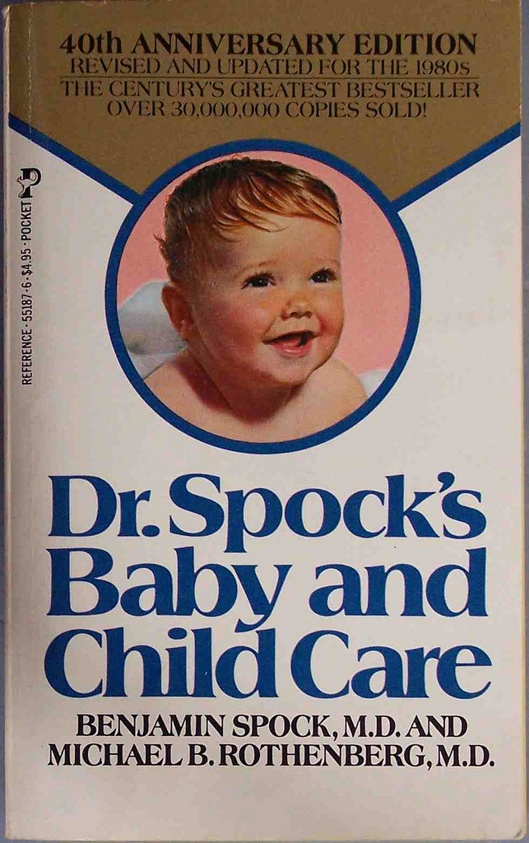
Notes:
Book published 1946 - one of best-sellers of all time.
1958 edition advocated babies sleeping on their fronts (inhalation vomit). Increase in SIDS (cot death) noted . Association with sleeping position identified by Peter Fleming, Bristol researcher, whose findings were published in BMJ in 1989. Anne Diamond, whose son died aged 4 months of cot death in 1991, spearheaded the campaign Back to Sleep. In UK SIDS numbers dropped rapidly. 1545/year in 1989, barely 200 now.

Slide 11
How?

Slide 12
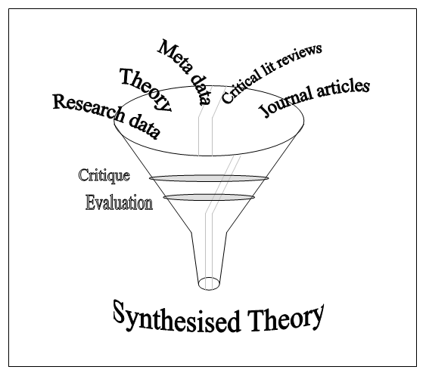
What are systematic reviews?
https://www.youtube.com/watch?v=2tSJdS9Zukc
Locate
Appraise
Synthesise

Slide 13
Who needs to know?
Notes:
Who needs to know about EBM?
We’d argue that everyone does – as we all make decisions about our health & when we do, it’s important those decisions are informed ones.

Slide 14
Common cold

Slide 15
Vitamin C
Vitamin D
Garlic
Echinacea
Corticosteroids
Nasal decongestants used alone
Antibiotics
Honey
Antihistamines
Oral antihistamine / decongestant / analgesic combinations
Non steroidal anti-inflammatory drugs (NSAIDs)
Vaccines (to prevent colds)
Steam inhalation
Paracetamol
Notes:
Some commonly used interventions to either treat or prevent the symptoms of a cold.
What’s likely to be effective & unlikely to be effective?

Slide 17
George’s story
https://www.youtube.com/watch?v=aFV7eFXsqP8
Notes:
3:42
https://www.youtube.com/watch?v=aFV7eFXsqP8

Slide 21
Notes:
SRV.
The choices that we make about health are not necessarily about treatments – it can also be about diet for example.
Every day in the media, we’re bombarded with claims about the effects of foods on our health.
On the screen now is a press statement from the World Health Organization, published in 2015.
It discussed the link between the consumption of processed meat and the risk of developing colorectal cancer.
It stated that, eating the 2 rashers of bacon each day, increases the risk of developing colorectal cancer by approx. 20%.
Lynda will go into the terms in more detail.

Slide 22
World Health Organization Classification of carcinogens
Notes:
Lynda- Let’s look at the first statement – that bacon and processed meat is carcinogenic.
This is the WHO carcinogen (which means cancer causing) classification.
What does this tell us? One answer.
What does this tell us about processed meats compared to smoking?.... Nothing.
This shows that processed meats cause cancer. They are in the same in group as smoking, but these groups tell us nothing about individual risk
October 2015 WHO statement:
Processed meat = Class I carcinogen. Link to bowel cancer. Others Class I carcinogens = smoking, asbestos
Baseline risk of bowel cancer = 5% If consume 50g processed meat /day risk rises to 6%
Absolute risk rises by 1%. Relative risk rise 20%
Damaging compounds (e.g. N-nitroso ) generated in preserving process e.g. high temperatures.
Smoking accounts for more than 1:4 cancer deaths in UK and nearly a fifth of all cancer cases.
Smoking raises risk of lung cancer 2000% (RR)

Slide 23
Can you design a headline?
Imagine you are the journalist reporting on this. What would your headline be?

Slide 24
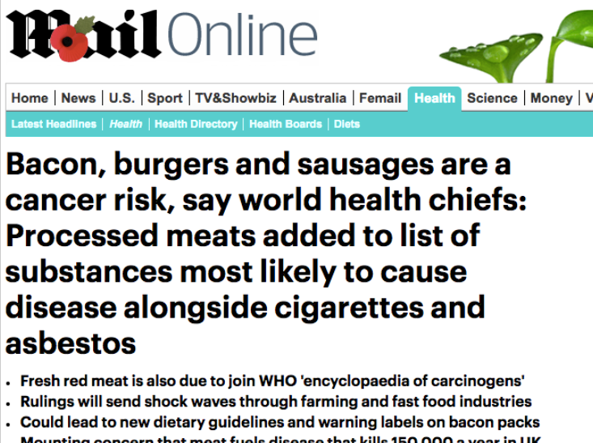
Notes:
MailOnline
Is the World Health Organization press release is reflected accurately and fairly in these headlines?

Slide 25
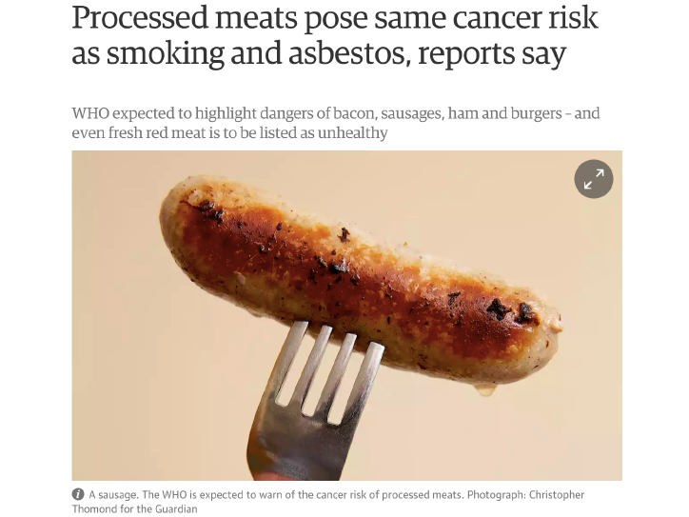
Notes:
Guardian newspaper.

Slide 26
Notes:
Telegraph

Slide 27
Notes:
SRV
Telegraph – rebuttal from scientists

Slide 28
Notes:
SRV
The Sun

Slide 29
Notes:
SRV
Daily Mail

Slide 30
Notes:
SRV
Guardian – Butchers strike back at claims
Have a talk amongst yourselves. What do you make of these headlines? Do you think they’re fair & accurate reflection of the WHO statement?
Responses from students.

Slide 31
Bacon causes cancer
What should we be asking in order to know the truth?

Slide 32
What is the evidence behind the claim?
What kind of studies provided the data (e.g. RCTs? Observational studies?)
Who were the participants?
Are we given information about our personal risk?
How do the risks compare? (e.g. between eating processed meat and smoking)
Might there be any harms in removing processed meat from our diet?
Notes:
What type of study?
Was it an RCT?
Who was the in?
How much bacon do I need to eat?
Does bacon really cause cancer?
Is it really as bad as smoking/asbestos?

Slide 33
Where?

Slide 34
Useful evidence-based links and interesting reading
bit.ly/CochraneUK

Slide 35
Thank you

