Slide 1
Why double blind, controlled randomized trials?

Slide 2
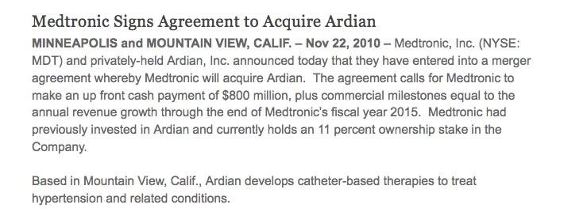

Slide 3
Symplicity HTN-1
study

Slide 4
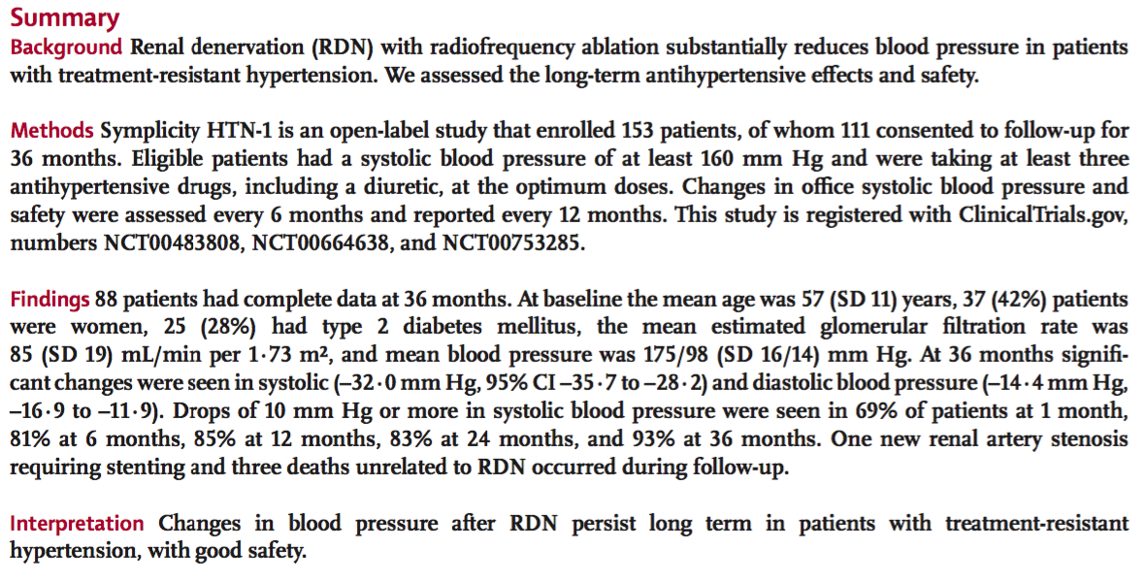
Symplicity HTN-1
study

Slide 5
Symplicity HTN-1
study
At 36 months:
BP down 32mm Hg systolic, 14mm Hg diastolic
Drop of 10mm Hg or more seen in 93% of patients

Slide 6
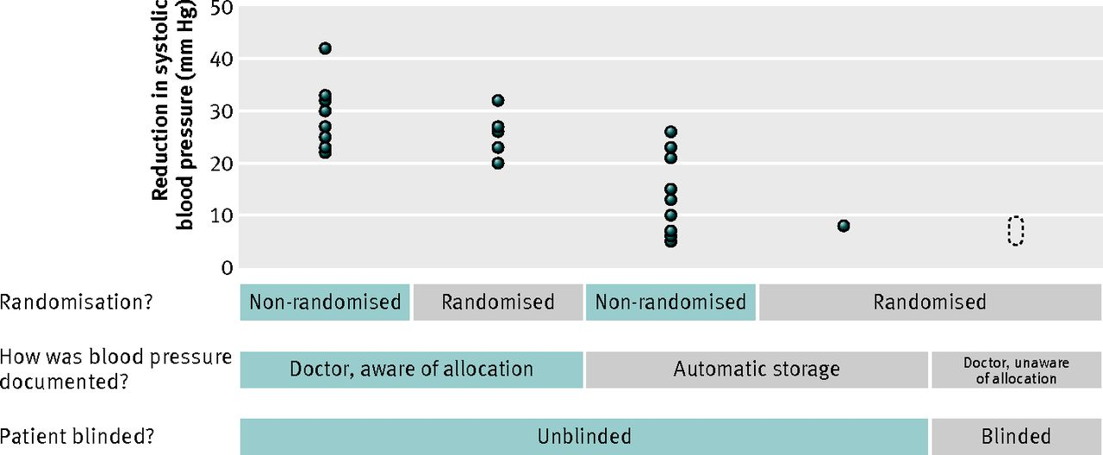
Reported reductions in systolic blood pressure according to whether there was randomisation, whether blood pressure was documented automatically or by a doctor, and whether there was blinding. Each point represents the point estimate of reduction in systolic blood pressure from one trial report.
Shun-Shin M J et al. BMJ 2014;348:bmj.g1937
©2014 by British Medical Journal Publishing Group
Notes:
Reported reductions in systolic blood pressure according to whether there was randomisation, whether blood pressure was documented automatically or by a doctor, and whether there was blinding.9 Each point represents the point estimate of reduction in systolic blood pressure from one trial report. As the quality of the trial design increased, the reported effect size decreased. The Symplicity HTN-3 trial is unique in being randomised, blood pressure being documented by a blinded member of staff, and the patient being blinded using a placebo procedure. This trial failed to meet its primary endpoint. Our mathematical prediction is that its effect size will be in the dotted area10

Slide 7
Symplicity HTN-3
study

Slide 8
Symplicity HTN-3
study
Blinded, randomized, sham-control group
Primary end point: change in BP and incidence of major adverse effects

Slide 9
Reported reductions in systolic blood pressure according to whether there was randomisation, whether blood pressure was documented automatically or by a doctor, and whether there was blinding. Each point represents the point estimate of reduction in systolic blood pressure from one trial report.
Shun-Shin M J et al. BMJ 2014;348:bmj.g1937
©2014 by British Medical Journal Publishing Group
Notes:
Reported reductions in systolic blood pressure according to whether there was randomisation, whether blood pressure was documented automatically or by a doctor, and whether there was blinding.9 Each point represents the point estimate of reduction in systolic blood pressure from one trial report. As the quality of the trial design increased, the reported effect size decreased. The Symplicity HTN-3 trial is unique in being randomised, blood pressure being documented by a blinded member of staff, and the patient being blinded using a placebo procedure. This trial failed to meet its primary endpoint. Our mathematical prediction is that its effect size will be in the dotted area10

Slide 10
Reported reductions in systolic blood pressure according to whether there was randomisation, whether blood pressure was documented automatically or by a doctor, and whether there was blinding. Each point represents the point estimate of reduction in systolic blood pressure from one trial report.
Shun-Shin M J et al. BMJ 2014;348:bmj.g1937
©2014 by British Medical Journal Publishing Group
Notes:
Reported reductions in systolic blood pressure according to whether there was randomisation, whether blood pressure was documented automatically or by a doctor, and whether there was blinding.9 Each point represents the point estimate of reduction in systolic blood pressure from one trial report. As the quality of the trial design increased, the reported effect size decreased. The Symplicity HTN-3 trial is unique in being randomised, blood pressure being documented by a blinded member of staff, and the patient being blinded using a placebo procedure. This trial failed to meet its primary endpoint. Our mathematical prediction is that its effect size will be in the dotted area10

Slide 11
Reported reductions in systolic blood pressure according to whether there was randomisation, whether blood pressure was documented automatically or by a doctor, and whether there was blinding. Each point represents the point estimate of reduction in systolic blood pressure from one trial report.
Shun-Shin M J et al. BMJ 2014;348:bmj.g1937
©2014 by British Medical Journal Publishing Group
Notes:
Reported reductions in systolic blood pressure according to whether there was randomisation, whether blood pressure was documented automatically or by a doctor, and whether there was blinding.9 Each point represents the point estimate of reduction in systolic blood pressure from one trial report. As the quality of the trial design increased, the reported effect size decreased. The Symplicity HTN-3 trial is unique in being randomised, blood pressure being documented by a blinded member of staff, and the patient being blinded using a placebo procedure. This trial failed to meet its primary endpoint. Our mathematical prediction is that its effect size will be in the dotted area10

Slide 13
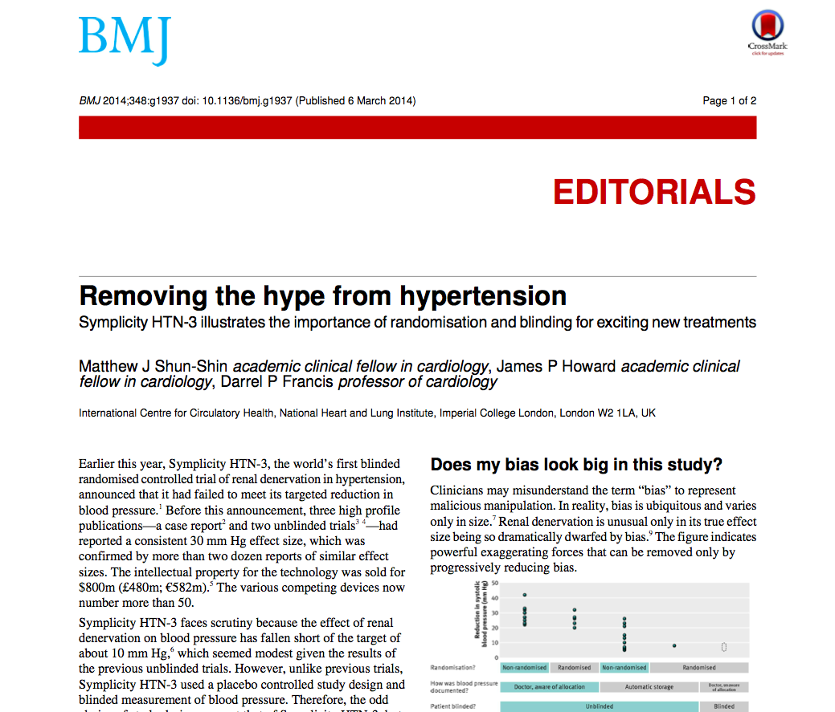
`

Slide 14
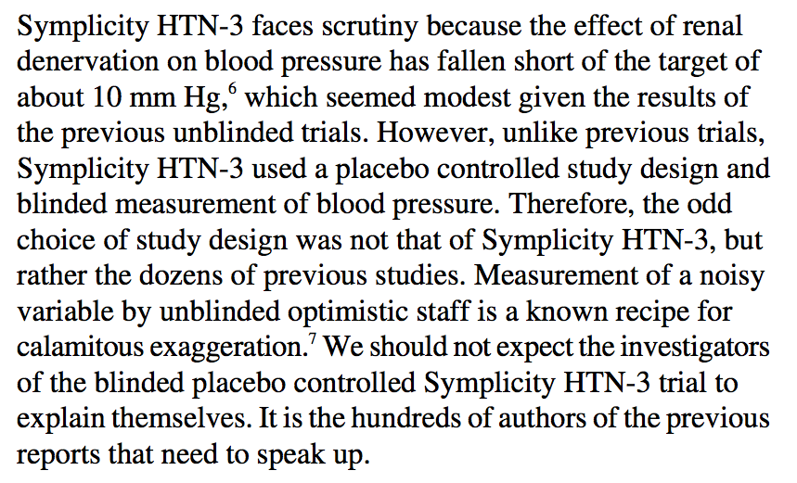

Slide 15
Reported reductions in systolic blood pressure according to whether there was randomisation, whether blood pressure was documented automatically or by a doctor, and whether there was blinding. Each point represents the point estimate of reduction in systolic blood pressure from one trial report.
Shun-Shin M J et al. BMJ 2014;348:bmj.g1937
©2014 by British Medical Journal Publishing Group
Notes:
Reported reductions in systolic blood pressure according to whether there was randomisation, whether blood pressure was documented automatically or by a doctor, and whether there was blinding.9 Each point represents the point estimate of reduction in systolic blood pressure from one trial report. As the quality of the trial design increased, the reported effect size decreased. The Symplicity HTN-3 trial is unique in being randomised, blood pressure being documented by a blinded member of staff, and the patient being blinded using a placebo procedure. This trial failed to meet its primary endpoint. Our mathematical prediction is that its effect size will be in the dotted area10

Slide 16
Reported reductions in systolic blood pressure according to whether there was randomisation, whether blood pressure was documented automatically or by a doctor, and whether there was blinding. Each point represents the point estimate of reduction in systolic blood pressure from one trial report.
Shun-Shin M J et al. BMJ 2014;348:bmj.g1937
©2014 by British Medical Journal Publishing Group
Notes:
Reported reductions in systolic blood pressure according to whether there was randomisation, whether blood pressure was documented automatically or by a doctor, and whether there was blinding.9 Each point represents the point estimate of reduction in systolic blood pressure from one trial report. As the quality of the trial design increased, the reported effect size decreased. The Symplicity HTN-3 trial is unique in being randomised, blood pressure being documented by a blinded member of staff, and the patient being blinded using a placebo procedure. This trial failed to meet its primary endpoint. Our mathematical prediction is that its effect size will be in the dotted area10

