Slide 1
Evidence-based principles of learning

Slide 2
Evidence-based principles of learning
Intended learning outcome:
Know how to apply key learning principles to EBM teaching
Notes:
ASK: Why do you teach? The most common response is likely to be “because I enjoy it”. Other examples will be related to helping people to learn, patient care (better doctors).
I will start by asking you to what extent has your previous experiences as a learner have shaped your intrinsic motivation and can you t5hink of examples and (see next slide)?
Then move to next slide
Link Intrinsic motivation to Need To kNow and learning as follows:
Today I am going to help you learn the skills and theoretical understanding that you need to know that will build on your intrinsic motivation to become better teachers of students and trainees, achieve more confidence in your capabilities as a medical educator, increase your satisfaction with you teaching role and patient care .
List the reasons on the flipchart.
Highlight intrinsic motivation; difference rom extrinsic motivation
SAY: This is an example of intrinsic motivation. Write this on flipchart – under Adult learning principles (Knowles).
Elicit an example of extrinsic motivation relevant to medical learning.
ASK: Why do you enjoy it? This will elicit the other factors above.
SAY: These are your values/philosophy of teaching. This is important to note for your portfolio. Our philosophy and values can determine the principles/beliefs that underpin our teaching practice. .
ASK: What do you believe are the features/principles to good teaching practice?
Note these on a flipchart; Separate out those that are general from those that are linked to Adult learning principles. The writing could be done by a member of the group.
ASK: How have you arrived at these teaching values/principles? The responses are likely to include previous experience of learning from (clinical) teachers. Emphasise experience in the development of their own learning (across beliefs, attitudes and skills). Then move to next slide

Slide 3
Adult Learning Principles
M Motivation is more intrinsic
KN Need to Know Relevance
O Orientation towards practical, problem solving
WL Workplace based learning – towards a role
E Experience is drawn upon
S Self -directed/autonomous
(M. Knowles 1984)
Notes:
SAY: Our discussion of how medical students and postgraduate trainees learn has identified the principles of Adult Learning as espoused by Malcom Knowles (1984) and referenced in the previous slide.
Say – The next question to the analysts is What else was going on? Whether my strategy was incidental or planned What theory may have underpinned this planning?

Slide 4
Creating Relevance in Learning Experience
What is the purpose of EBM?
How is it achieved?

Slide 5
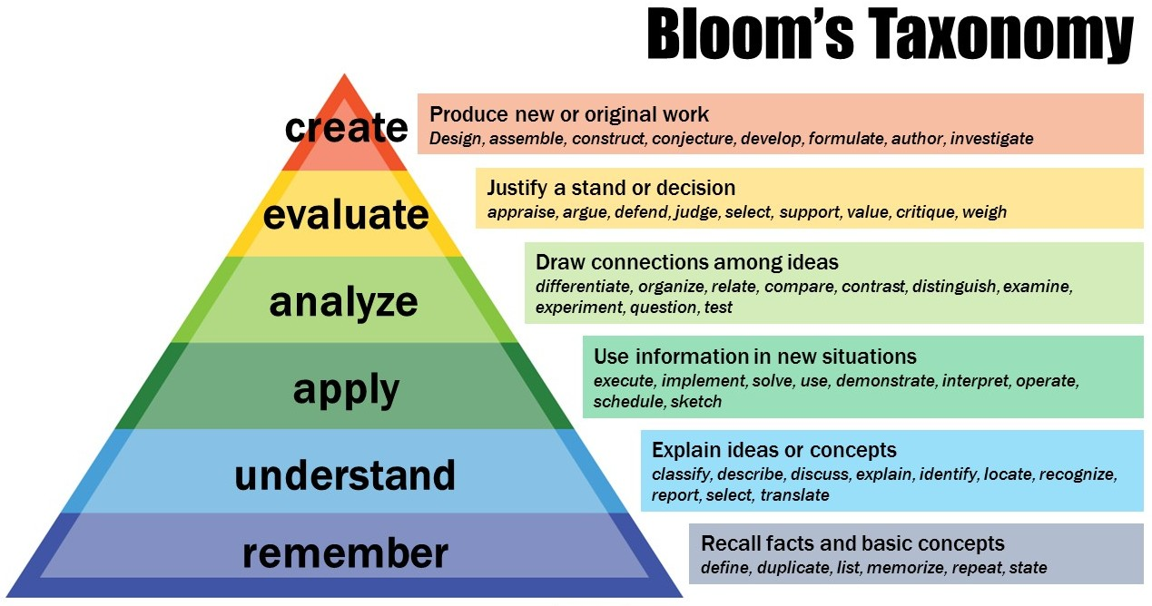

Slide 6
Experiential Learning (Kolb 1984)

Slide 7
Evidence-Based Principles of Learning
Frequent contact with tutors/trainers.
Cooperation and collaboration with other learners.
Active involvement in thinking and learning.
Engagement with prior knowledge and experience.
Time on task in deliberate practice.
Timely, specific feedback.
A challenging, yet supportive, learning environment.
Relevance to learners.
Encouragement toward independent learning.
Education is patient-centred.
Notes:
SAY: You have identified several general principles that explain why a given educational activity works. Lets compare with the literature. We could fill a whole room with the studies that have examined various interventions, teaching methods and activities and looking across those studies we find roughly these same 9 principles reinforced time and time again. These principles help us to EXPLAIN WHY a given educational activity works and helps us to design or predict what activities will be successful. Put simply, the more of these principles you can put into operation, the more likely it is that you will be able to create a powerful, significant learning experience. Let’s test this against your own case examples.
EXPLAIN: “time on task” – it means time focused on the meaningful thing you are supposed to be learning. If you set students a lab exercise and find them standing around talking about the last film, they may be spending time in the lab or clocking contact hours, but they are not “on-task” practicing science! Goal-directed, is just that – setting a specific goal and then practicing it (in an outpatient clinic a medical student might want to learn how to take a history or they might want to practice doing an examination of the knee – this should be their goal for an afternoon and they should practice that).
REFER: participants to the bibliography below if they want to read any of the original syntheses (this is a synthesis of the syntheses!)
NOTE: we will return to these principles throughout the day, showing how the practices we are teaching you are consistent with or are ways of implementing particular principles.
Below you can find longer explanations of each principle to help you clarify them:
There is a large body of evidence based on research in the Anglo-American context and in Europe that describes the kinds of learning environments and teaching practices that enable learning in higher education. From these extensive bodies of evidence, we know that students in higher education learn best when there is:
Frequent contact with academics in and out of class. Students benefit from interaction with their teachers. It is both motivating to students and promotes their engagement with their studies.
Cooperation and collaboration with other students. Learning is an essentially social activity. Collaboration among students allows them to articulate, test and challenge their assumptions, gives them access to the knowledge and experience of their classmates and a variety of perspectives on the topic and processes for learning it.
Active involvement in thinking and learning. Learning is an active, not a passive process. Learning happens when students read, talk, write, explain, make connections between ideas, try things out and observe the results, analyse, evaluate and organise their knowledge in meaningful ways. Good instruction engages students in actively processing and using new ideas rather than just listening to or watching their teachers. Teaching is simply the means of promoting student learning, not an end in itself.
Recognition of and critical engagement with prior knowledge and experience. Students come to higher education with prior knowledge and experience that can help or hinder new learning. If misconceptions and assumptions are identified and then challenged, it facilitates deeper understanding. If existing knowledge becomes linked with new knowledge, it can be more easily accessed, retrieved and applied later. Adult learners, in particular, need to feel that their experience of the world is respected by taking interest in what they bring to the educational environment, regarding them as colleagues, encouraging them to discuss their experience.
Time on task in goal-directed practice. Students need to put in time and energy on learning. They must practice key skills, attending to particular goals or criteria.
Timely, specific feedback that gives guidance about progress and how to improve. Feedback on student performances (e.g. writing an essay, giving a presentation, answering a question, demonstrating a skill) is one of the most powerful methods of instruction. Feedback helps to clarify what good performance looks like, and provides useful information so that students can monitor their own performance so they can close the gap between the desired and their actual performance.
A challenging, yet supportive, learning environment. Students do best when we set and communicate high expectations for them. However, as we challenge them, we also need to provide developmentally appropriate emotional, social and intellectual support.
Relevance to students’ goals and intrinsic interests. Students are more motivated when they have some control over their learning and when they see its relevance to their own lives, goals and interests. Motivation also depends upon them expecting to succeed in the task and perceiving a supportive environment. Adult learners, in particular, often pursue higher education in order to meet their own, pragmatic goals. They may thrive on situations in which the relevancy to practice is most clear, such as practical fieldwork experiences, interacting with real life scenarios and shifting from theory and classroom work to hands-or, real-life problem-solving.
Encouragement to become independent in their learning. Students often need help in learning how to learn. Becoming a self-directed, autonomous learner involves becoming proficient at assessing a task and its requirements, planning their approach, evaluating their own knowledge base and (learning) needs, identifying and effectively using resources, applying and monitoring various strategies and, finally, assess their own performance against internalised performance standards. Independent learners are the professionals of the future. Mature learners are often internally motivated and self-directed. Recognising this level of independence and supporting it helps demonstrate respect and maintain motivation.
Bibliography
Ambrose, S.A., M.W. Bridges, M.C. Lovett, M. DiPietro, M. K. Norman. (2010). How Learning Works: 7 Research-Based Principles for Smart Teaching. Jossey-Bass: San Francisco.
Bransford, J., A. Brown and R. R. Cockings (eds) (2000). How People Learn: Brain, Mind, Experience and School. National Academy Press: Washington, DC. Available at http://www.nap.edu.
Gamson, Z. F. (1991). A Brief History of the Seven Principles for Good Practice in Undergraduate Education, New Directions for Teaching and Learning, No. 47, pp 5-12.
Knowles, M. S. et al (1984) Andragogy in Action. Applying modern principles of adult education, San Francisco: Jossey Bass.
Ramsden, P. (2003) Learning to teach in higher education:Second edition. London: Routledge.

Slide 8
Bibliography
Ambrose, S.A., M.W. Bridges, M.C. Lovett, M. DiPietro, M. K. Norman. (2010). How Learning Works: 7 Research-Based Principles for Smart Teaching. Jossey-Bass: San Francisco.
Bransford, J., A. Brown and R. R. Cockings (eds) (2000). How People Learn: Brain, Mind, Experience and School. National Academy Press: Washington, DC. Available at http://www.nap.edu.
Gamson, Z. F. (1991). A Brief History of the Seven Principles for Good Practice in Undergraduate Education, New Directions for Teaching and Learning, No. 47, pp 5-12.
Knowles, M. S. et al (1984) Andragogy in Action. Applying modern principles of adult education, San Francisco: Jossey Bass.
Pratt et al (2001) Development and use of the Teaching Perspectives Inventory (TPI). www.teachingperspectives.com

