Slide 1
Role & Relevance of Cochrane UK to trainees
Emma Plugge
March 2018

Slide 2
Cochrane
Cochrane UK
Trainee Engagement

Slide 3
What is Cochrane?
Cochrane is a global independent network of over 36,000 researchers, professionals, patients, carers and people interested in health.
Cochrane respond to the challenge of making the vast amounts of best available evidence generated through research useful for informing decisions about health.
Cochrane is a not-for-profit organization with collaborators from more than 120 countries working together to produce credible, accessible health information that is free from commercial sponsorship and other conflicts of interest.

Slide 4
Cochrane UK
One of 41 regional centres & branches supporting the global work of Cochrane
‘To improve health by promoting the production, understanding and use of high quality research evidence by patients, healthcare professionals and those who organize and fund our healthcare services.’
Funded by National Institute for Health Research (NIHR)

Slide 5
Key programmes of work
Learning and Development Programme
- provides training events and resources for all UK- and Ireland-based Cochrane contributors and others, who are interested in learning more about Cochrane, Cochrane Reviews and disseminating evidence
Engagement Programme
- disseminates Cochrane Reviews and other evidence to all our key audiences, through social media, events and other communications projects

Slide 6
Evidently Cochrane blog
evidentlycochrane.net

Slide 7
Blogshots
https://cochraneblogshots.tumblr.com/

Slide 8
Students 4 Best Evidence
s4be.org

Slide 9
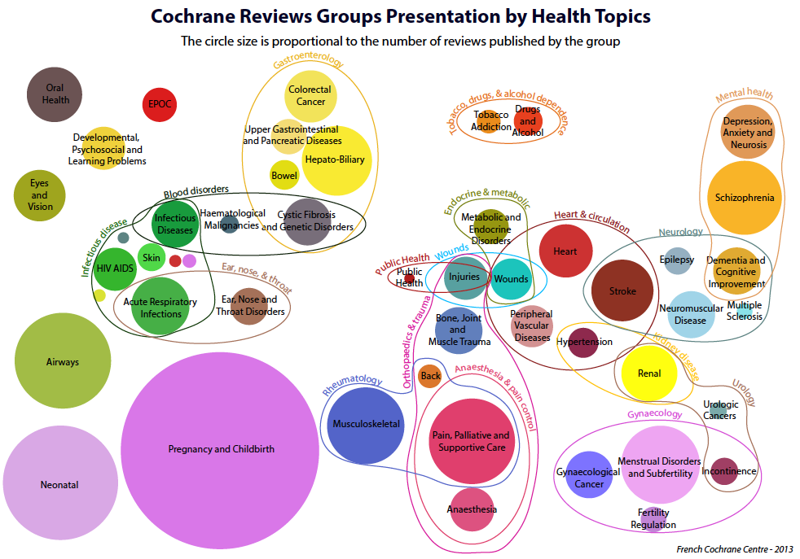
Cochrane review groups by health topic. The circle size is proportional to the number of reviews published by the group
Notes:
This is about demonstrating the reach of our organisation by topic coverage

Slide 10
Key programmes of work
Learning and Development Programme
- provides training events and resources for all UK- and Ireland-based Cochrane contributors and others, who are interested in learning more about Cochrane, Cochrane Reviews and disseminating evidence
Engagement Programme
- disseminates Cochrane Reviews and other evidence to all our key audiences, through social media, events and other communications projects

Slide 11
Trainee Engagement Priorities
Supporting an official trainee committee
Increasing awareness of evidence-based medicine in general and the work of Cochrane in particular amongst trainees
Developing opportunities for trainees to work at Cochrane UK
(Working with CRGs to enable more trainees to work with them)

Slide 12
Thank you Contact details: Emma Plugge Senior Fellow in Public Health, Cochrane UK
emma.plugge@cochrane.nhs.uk

