Slide 1
The future is not a destination awaiting our arrival like Land’s End or Tasmania

Slide 2
It is much more like the Great Western Railway , something we imagine, design, plan and build

Slide 3
It is much more like the Great Western Railway , something we imagine, design, plan and build

Slide 4
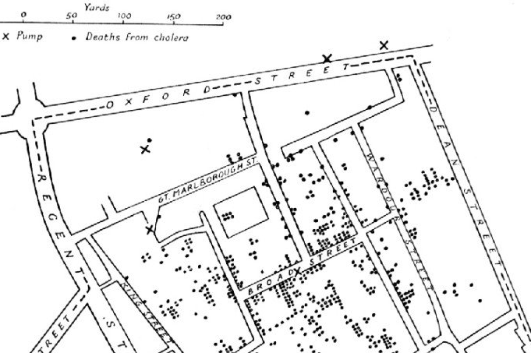
We have had 2 healthcare revolutions, with amazing impact
The First was the public health revolution
The Second has been the technological revolution supported by 50 years of increased investment & 20 years of evidence based medicine, Cochrane, quality and safety improvement eg
Antibiotics
MRI & CT
Coronary artery bypass graft surgery
Hip & knee replacement
Chemotherapy
Radiotherapy
Randomised controlled trials
Systematic reviews

Slide 5
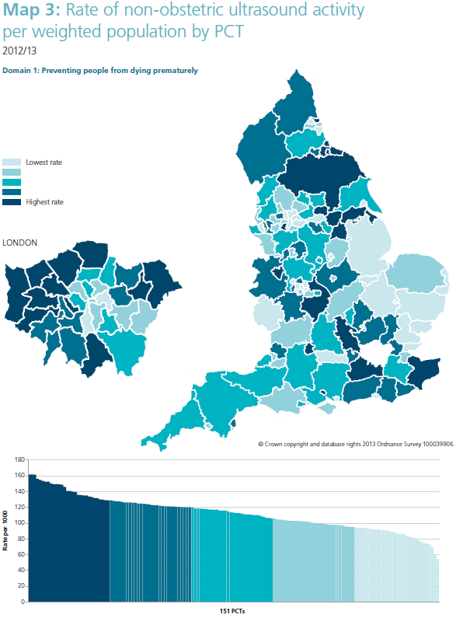
after 50 years of progress all societies still face three massive problems.
The first is unwarranted variation in healthcare ie ”Variation in utilization of health care services that cannot be explained by variation in patient need or patient preferences.”
Jack Wennberg
Variation reveals the other two problems

Slide 6
The first is OVERUSE of lower or zero value interventions which results in
waste of resources
harm
Point of optimality
Benefits
Increment in
Value with each
increment in
resources
Harms
Investment of resources
Notes:
One of the benefits of evidence-based medicine was that it emphasised the need to ensure that the only interventions being offered were those for which there was strong evidence that they did more good than harm. However, the balance of good to harm changes as the amount of resources invested in a health service increases. This was first demonstrated by Avedis Donabedian in 1980. Donabedian called the point beyond which further investment of resources would not increase value for the population the point of optimality.
This is illustrated in the figure on the ppt - emaphasise that THISIS THE MOST IMPORTANT PICUTE IN HEALTHCARE
Ask the participants to identify examples working in pairs for 2 minutescommonly the y produce
Antibiotics
Chemptherapy ion the last week of life
Elderly people with multiple disorders dying in intensive care
Rarely do the comment on
The last 10% in the increase in imaging ( going up at 8-10% per year)
The last 10% in the increase in lab testing ( going up at 8-10% per year)
Emphasise THIS HAS NOTHING TO DO WITH MONEY
[raise the choosing wisely campaign http://www.choosingwisely.org amd the BMJ’s too Much medicine http://www.bmj.com/too-much-medicine
Table. The 6 General Competencies of the Accreditation Council for Graduate Medical Education/American Board of Medical Specialties, and the Proposed Seventh Competency
Medical Knowledge
Patient care
Professionalism
Interpersonal and communication skills
Practice-based learning and improvement
Systems-based practice
Proposed new competency: cost-conscious care and stewardship of resources
Source: Weinberger, S.E., (2011) Providing high value, cost-conscious care: a critical seventh general competency for physicians. Annals of Internal Medicine 155:386-388.

Slide 7
The second is Underuse of high value interventions which results in
1. Preventable disability and death eg if we managed atrial fibrillation optimally there would be 5,000 fewer strokes and10% reduction in vascular dementia, and
2. inequity
Notes:
This was in the NHS Atlas of Variation

Slide 8
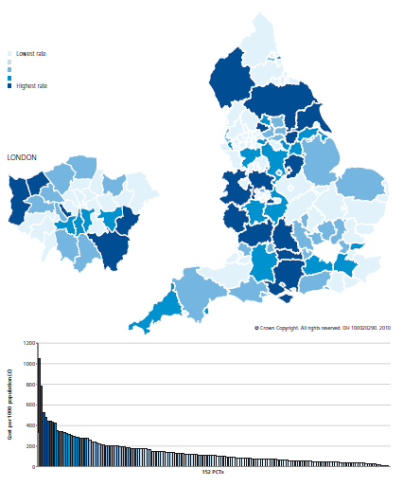
Hip replacement
in most deprived populations compared with least derived populations
Knee replacement in most deprived populations compared with least derived populations
31
33
Provision less than expected Provision more than expected
100
THERE IS ALSO TRIPLE WHAMMY HEALTHCARE !
OVERUSE +
UNDERUSE +
UNWARRANTED VARIATION
Notes:
This was in the NHS Atlas of Variation

Slide 9
In the next decade need and demand will increase by at least 20 % so what can we do?
Well, we need to continue to
1. Prevent disease, disability, dementia and frailty to reduce need
2.Improve outcome by providing only effective, evidence based interventions
3. Improve outcome by increasing quality and safety of process
4. Increase productivity by reducing cost
These measures reduce need and improve efficiency BUT we also need to increase value

Slide 10
The Aim is triple value
Allocative, determined by how well the assets are distributed to different sub groups in the population
  Between programme
  Between system
  Within system
Technical, determined by how well resources are used for outcomes for all the people in need in the population
Personalised value, determined by how well the outcome relates to the values of each individual
waste is anything that does not add value and as the Academy’s re[port emphasises we need to develop a ‘culture of stewardship’ to ensure the NHS will be with us in 2025 and 2035
Notes:
It is useful to emphasise that there are two types of value , allocative and technical relate primarily to populations, personalised to the individual
This report from the academy of medical royal colleges in 2015 calls for a culture of stewardship

Slide 11
Costs are not only £££ but also
Carbon costs,
Time, particularly the Time of patients and carers and
Lost opportunity
v
Efficiency
Outcomes/costs
Productivity
Outputs/Costs

Slide 12
Value
Are the right patients being
seen or is there either 1. harm from
over diagnosis or
2. inequity from
underuse
v
Efficiency
Outcomes/costs
Productivity
Outputs/Costs

Slide 13
Cost effectiveness is not the same as value
This does not mean good economic analysis is essential to influence policy (although it certainly helps), but good policymakers will always be asking the question ‘ what is the opportunity cost of this new initiative?’ . Policymakers also therefore can be more numerate than scientists often give them credit for, and have access to well trained statisticians.
Chris Whitty
What makes an academic paper useful for health policy?
BMC Medicine (2015) 13:301

Slide 14
THE RIGHTCARE METHOD OF INCREASING VALUE FOR POPULATIONS AND INDIVIDUALS IS BY
CITIZENS & COMMISSIONERS
  Ensuring that every individual receives high personal value by providing people with full information about the risks and benefits of the intervention being offered and relating that to the problem that bothers them most and their values and preferences
  Shifting resource from budgets where there is evidence from unwarranted variation of overuse or lower value to budgets for populations in which there is evidence of underuse and inequity
  Ensuring that those people in the population who will derive most value from a service reach that service
  Implementation of high value innovation funded by reduced spending on lower value interventions for the population
  Increased rates of higher value intervention eg helping a higher proportion of people die well at home funded by reduced spending on lower value care in hospital in that population
PATIENTS & CLINICIANS & PROVIDERS

Slide 15
THE RIGHTCARE METHOD OF INCREASING VALUE FOR POPULATIONS AND INDIVIDUALS IS BY
  Ensuring that every individual receives high personal value by providing people with full information about the risks and benefits of the intervention being offered and relating that to the problem that bothers them most and their values and preferences

Slide 16
The value this patient
places on benefits & harms of the options and on risk taking
Patient
Report of the impact of the decision on problem that was bothering
them most
Evidence,
Derived from the study of groups of patients
Decision
The clinical condition of this patient; other diagnoses, risk factors including genomic information and in particular their problem, what bothers them psychologically & socially
  And if genomic information is included the term used is usually precision medicine rather than personalised medicine
Notes:
Personalised and precision medicine
health-care innovations involing molecular diagnostics and pharmacogenomics.”
targeting therapies for patients who are already ill. It also includes the ability to identify healthy individuals at elevated risk of disease, enabling preventive measures to be targeted towards those who could benefit most.”
Source: Dzau V.J., Ginsberg, G.S. van Njuys, K., Agus, D., Goldman, D. (2015) Aligning incentives to fulfil the promise of personalised medicine. Lancet 2015; 385:2118.

Slide 17
  5.The Rightcare method for ensuring that every individual receives high personal value is providing people with full information about the risks and benefits of the intervention to prevent overuse through over diagnosis and overtreatment by
  Ensuring that what is bothering the individual patient most is articulated and recorded by the service
  Providing information about the risks and benefits of every decision eg the decision to offer a drug, is presented in absolute numbers
  Providing decision aids for complicated decisions in which there is a significant risk of harm
  Helping the patient reflect on their values, both online and face to face, in the light of the information presented,
  Eliciting patient feedback to ensure these steps are taking place

Slide 18
We are now in the thirdhealthcare revolution
The First The Second the Third
Antibiotics
MRI
CT
Ultrasound
Stents
Hip and knee replacement
Chemotherapy
Radiotherapy
RCTs
Systematic reviews
Citizens
Knowledge Smart
Phone

Slide 19
THE RIGHTCARE METHOD OF INCREASING VALUE FOR POPULATIONS AND INDIVIDUALS IS BY
  2. Shifting resource from budgets where there is evidence from unwarranted variation of overuse or lower value to budgets for populations in which there is evidence of underuse and inequity

Slide 20
”
Cancer £7Bn
Respiratory £5Bn
Gastro-
Intestinal
£4Bn
Notes:
20
Mental health £11 Bn directly, perhaps another £5 Bn in hidden costs of people with physical problems with significant psychological factors at this point participants will say , rightly, that lots of people have more than one condition , so move on to the next slide

Slide 21
£11Bn!
At this point Gps’ will say
“but lots of people have more than one disease”
Mental
Health
Cancer
Respiratory
Gastro-
intestinal
Notes:
21
Mental health £11 Bn directly, perhaps another £5 Bn in hidden costs of people with physical problems with significant psychological factors at this point participants will say , rightly, that lots of people have more than one condition , so move on to the next slide

Slide 22

2. We are working to develop programme budgets determined by characteristic such being elderly with frailty
Mental
Health
Many people have more than one problem ; they have complex needs.
GP’s are skilled in managing complexity but when one of the problems becomes complicated the Generalist needs Specialist help
Cancers
Respiratory
Gastro-
intestinal
Notes:
22
You can often see the GPs in the room concerned about the focus on single conditions so emphasise that we also need to focus on subgroups of the population defined by a comon characteristic such as having multipl conditions

Slide 23
Within Programme,
Between System
Marginal analysis is a clinician responsibility
Asthma
COPD
(Chronic
Obstructive
Pulmonary
Disease)
Apnoea
Cancers
Respiratory
Gastro-
instestinal
Notes:
23

Slide 24
THE RIGHTCARE METHOD OF INCREASING VALUE FOR POPULATIONS AND INDIVIDUALS IS BY
  Ensuring that every individual receives high personal value by providing people with full information about the risks and benefits of the intervention being offered and relating that to the problem that bothers them most and their values and preferences
  Shifting resource from budgets where there is evidence from unwarranted variation of overuse or lower value to budgets for populations in which there is evidence of underuse and inequity
  Ensuring that those people in the population who will derive most value from a service reach that service

Slide 25
  3. Ensuring that those people in the population who will derive most from a service are in receipt of that service if necessary by reducing the number of people seen by that service directly
All people with
the condition
People
receiving
the specialist
service
People who
would benefit
most from the specialist service
This requires clinicians including specialists to become population focused as well as delivering high quality care to referred patients and the surgical services initiative which is part of the Efficiency programme will develop this approach
Notes:
Here isan example of the type of problems that clinicians need to tackle , particulatrly because … next ppt

Slide 26
THE RIGHTCARE METHOD OF INCREASING VALUE FOR POPULATIONS AND INDIVIDUALS IS BY
  4. Implementation of high value innovation funded by reduced spending on lower value interventions for the population
  5. Increased rates of higher value intervention eg helping a higher proportion of people die well at home funded by reduced spending on lower value care in hospital in that population

Slide 27
  4. Implementation of high value innovation eg troponin in heart disease funded by reduced spending on lower value intervention in the cardiovascular programme budget
Resources required for
the innovation
Innovation adopted
Resources freed by reducing lower value activity

Slide 28
THE RIGHTCARE METHOD OF INCREASING VALUE FOR POPULATIONS AND INDIVIDUALS IS BY
  Ensuring that every individual receives high personal value by providing people with full information about the risks and benefits of the intervention being offered and relating that to the problem that bothers them most and their values and preferences
  Shifting resource from budgets where there is evidence from unwarranted variation of overuse or lower value to budgets for populations in which there is evidence of underuse and inequity
  Ensuring that those people in the population who will derive most value from a service reach that service
  Implementation of high value innovation funded by reduced spending on lower value interventions for the population
  Increased rates of higher value intervention eg helping a higher proportion of people die well at home funded by reduced spending on lower value care in hospital in that population

Slide 29
Optimise resource use for each system by carrying out Within System Marginal Analysis Using the STAR tool – Socio Technical Allocation of Resources
Asthma
COPD
(Chronic
Obstructive
Pulmonary
Disease)
Apnoea
Cancers
Respiratory
Gastro-
instestinal
Triple Drug
Therapy
Rehabilitation
Stop Smoking
Imaging
O2
Notes:
29
The first point is to point out that allocative decisions are also made within each system of care and and there was an excellent piece of work done by the london respiratory clinical community using the STAR tool http://www.health.org.uk/learning/star/ to move resources from triple drug therapy to smoking cession and rehabilitation. Now ask the group what they would do if asked to fund more resources for glaucoma and use the next ppt

Slide 30
1.Is the service for people with seizures & epilepsy in Thames Valley of higher value than the service in East Anglia?
2. Who is responsible for service for all the women with pelvic pain in South Yorkshire?
3.How many liver disease services are there in England and how many should there be?
4. Is the service for people with asthma in oxfordshire of higher value than the service in Cambridgeshire?
5.Who is responsible for the quality outcome and value of the service for people with depression in Oxfordshire ?

Slide 31
The Care Archipelago
GENERAL MENTAL
PRACTICE HEALTH
COMMUNITY
HEALTH HOSPITAL
SERVICES SERVICES
SOCIAL
SERVICES

Slide 32
The Commissioning Archipelago
152
Local
Authorities
211 CCG’s
GP/
Pharmacists/
optometrists
Public
Health
Specialist
commissioning
Notes:
You can point out that even small and straightforward health challenges , like deafness in children have four different types of commissioner involved

Slide 33
JURISDICTIONS INSTITUTIONS
PROFESSIONS
REGULATORS AND INSPECTORS
Complexity is the dynamic state between order and chaos
Kieran Sweeney, Complexity in Primary care
Notes:
At this point introduce the terms linear and non linear and their synonyms simple and complex
Bureaucracies are good at simple, linear tasks such as advertising jobs and arranging the interviews and appointments fairly, or receiving blood samples and sending back biochemical test results however most health challenges are complex but not equally complex

Slide 34
New Models of care will ensure that People receive care that is co-ordinated around their needs and supports them to live the lives they want to lead
Super
Specialist
Self-care
Informal care from family and voluntary help
Generalist
Specialist
Notes:
This is only one way of depicting a system the next ppt shows another

Slide 35
Population healthcare focuses primarily on delivering care to populations defined by a common need which may be a symptom such as breathlessness, a condition such as arthritis or a common characteristic such as frailty in old age, not on institutions , or specialties or technologies. Its aim is to maximise value for those populations and the individuals within them and New Models of Care are evolving to meet the needs of populations and individuals
Notes:
This is the approach to healthcare that complements the institutional approach
Ask participants to work in pairs to agree what they understand by the meaning of the term population; different perspectives will be given by people working in hospitals and those responsible for commissioning or in the public health service
At this stage in the workshop ask participants to turn to their neighbours and discuss for two minutes what they mean by the term system,

Slide 36

Map of Medicine - COPD
Work like an ant colony; Neither markets nor bureaucracies can solve the challenges of complexity

Slide 37
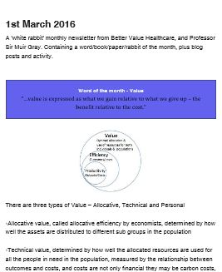
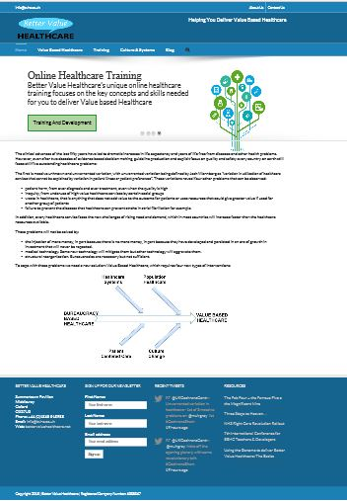


Sign up to receive Better Value Healthcare’s monthly briefing, sent on the 1st of every month –
white rabbits!
Sign up from our homepage –
www.bettervalue healthcare.net
Or go to eepurl.com/8kEyT

