Slide 1
Media and Dissemination
UK Symposium
March 2016
Jo Anthony
Katie Abbotts
Sarah Chapman

Slide 2
Dissemination Objective
Goal 3: Strategy to 2020
To make Cochrane the ‘home of evidence’ to inform health decision making, build greater recognition of our work, and become the leading advocate for evidence-informed health care.
Targeted knowledge transfer of Cochrane evidence and content in order to communicate the difference and impact Cochrane Reviews make.
There is an audience for every Cochrane Review, however small.

Slide 3
Formal Cochrane Review dissemination channels
Global Press release.
Targeted dissemination: PA wires news story/Buzzfeed
Podcast (usually recorded by one or more authors).
Social media activity (via The Cochrane Library Facebook and @CochraneLibrary Twitter account).
Featured in a Cochrane CDSR editorial (and possibly accompanied by a Special Collection).

Slide 4
Formal Cochrane Review dissemination activities
Included in the list of New & Highlighted Cochrane Reviews on The Cochrane Library homepage.
A featured Cochrane Review on the Cochrane.org homepage.
Listing as a highlight in Wiley’s monthly round up marketing email to subscribers.
Cochrane Journal Club (including a podcast and slide-set).
Inclusion in The Cochrane Library iPad edition – monthly.

Slide 5
Other things to think about
Share your review with other researchers via ResearchGate (http://www.researchgate.net/).
Translating the research into other languages.
Please make use of your institution’s public relations policy and media unit.
Please think about requesting that stakeholders disseminate your review through their master contact list.
Is your review a co-publication?
Think about your dissemination pre and post publication and use as many channels as you can!
Make use of the Cochrane Dissemination process.

Slide 6
Resources available to you
Cochrane Dissemination checklist – the process.
Cochrane ‘how to’ document - Press Release and Top Tips for media engagement
Cochrane Dissemination Brief – new for 2016.
Please make use of your institution’s public relations policy and media unit.
CEAD and CEU support
Translating the research into other languages.
Get in touch as early as you can in the editorial process.

Slide 7
Who do you go to?
Media and Dissemination:
Communication and External Affairs Department (CEAD) cead@lists.cochrane.org
Jo Anthony: janthony@cochrane.org
CEU: Toby Lasserson: tlassersson@cochrane.org
Blogs: Evidently Cochrane/Blogshots/UK social media
Cochrane UK: Sarah Chapman, Katie Abbotts
sarah.chapman@cochrane.nhs.uk
katie.abbotts@cochrane.nhs.uk

Slide 8
Dissemination examples

Slide 9
There is an audience for every review
Health media
Social media, blogs, blog shots, podcasts
UK campaigning groups e.g. Cycling Safety
Patient Groups e.g. Sling the mesh
UK charities e.g. Eczema Society
Professional bodies e.g. Royal College of Gynecologists and Obstetricians
“PR is an art not a science! No guaranteed outcomes”

Slide 10
Tricyclics and related drugs for treating bedwetting in children
No press release
Used PLS instead, sent tailored email to warm press contacts, after publication
Daily Mail considered interview with author in Australia
Mumsnet considered Q&A chat in their forums
Results = no coverage but warm contacts for next time

Slide 11
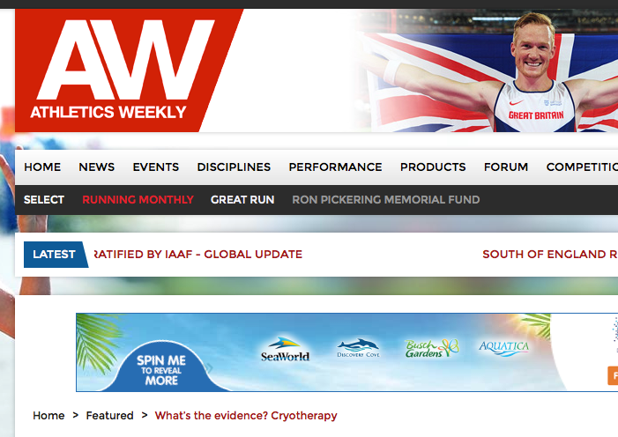
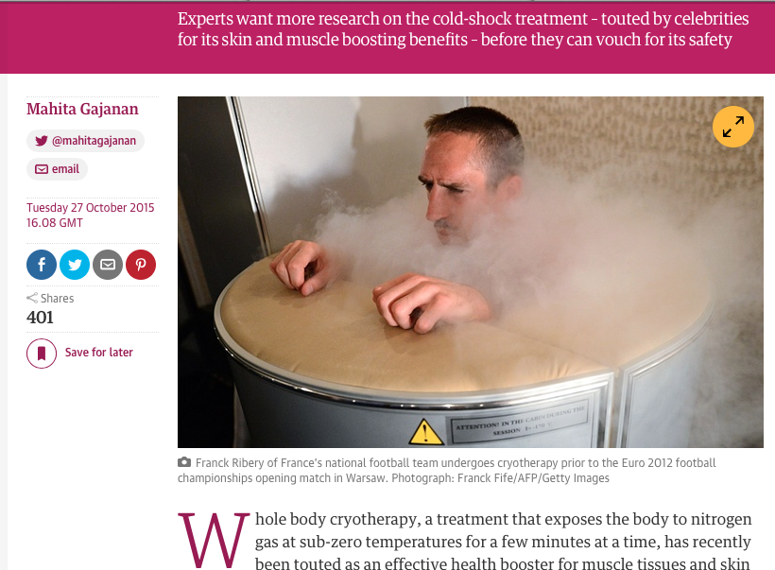
Whole-body cryotherapy for preventing and treating muscle soreness after exercise
Dear All
With the rugby world cup coming we thought it might be useful to re-share this Cochrane review with you, about cryotherapy or exposure to extremely cold air. This is a treatment favoured by professional sports people, but the recent Cochrane review points towards it not working. Some rugby teams are known to favour this treatment.
Author Joseph Costello, from the University of Portsmouth is available for interview.
The full review can be read here: http://www.cochrane.org/CD010789/MUSKINJ_whole-body-cryotherapy-preventing-and-treating-muscle-soreness-after-exercise?
Cochrane Podcast on this subject here: http://www.cochrane.org/podcasts/10.1002/14651858.CD010789.pub2
Thank you, Katie Abbotts
Cochrane UK

Slide 12
Dissemination beyond media
Ketogenic and other dietary treatments for epilepsy: “I will read it with interest.” Delphine van der Pauw Epilepsy Research UK.
Specific allergy immunotherapy for the treatment of atopic eczema: “We have tweeted and will pass to research team” Lisa Bickerstaff, British Skin Foundation
Cycling infrastructure (changes to the road environment) for reducing cycling injuries in cyclists: “Thank you for sending us your e-mail summary of the results of you recent research. I wonder whether you would be good enough to forward me a copy of the research / publication” Duncan Dollimore, CTC, The national cycling charity

Slide 13
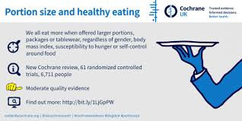
Portion, package or tableware size for changing selection and consumption of food, alcohol and tobacco
Author contacted central team many months ahead
A full dissemination plan was made with input from authors, Uni of Cambridge press office, PR agency as well as Cochrane UK and wider collaboration team
Allowed time to develop longer lead assets e.g infographics, blogs, podcasts – all ready for publication date
Two media spokespeople available
International media outreach resulting in coverage in most UK national papers and international TV coverage
Highest viewed Cochrane review in 2015

Slide 14
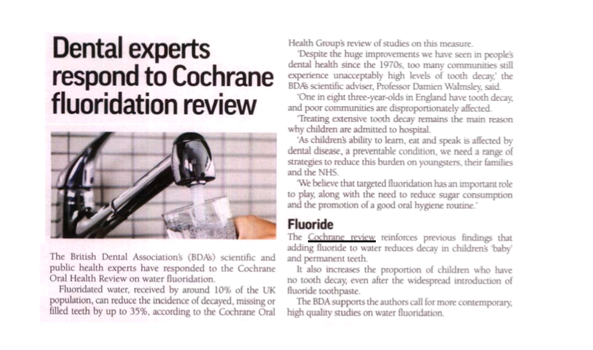
Water fluoridation for the prevention of dental caries
No press release, but key messages agreed and drafted
Final draft of review available for media under embargo
Tailored email drafted and sent ahead of publication to key contacts at New York Times, Guardian, dental press
Cochrane Central team alert international comms team to send to contacts
UK Cochrane centre set up dental press list
Highlights: The Dentist, Dentistry, BDJ

Slide 15
What to do?
Trust but assist the process, news worthy reviews will be picked up by the central team and identified for press release and media push
Advance notice is welcome and important – contact Jo Anthony
Niche reviews with strong findings – remember there is an audience for every review

Slide 16
Review dissemination and Cochrane UK
Sarah Chapman
MEs meeting
Cochrane Birmingham
March 2016

Slide 17
I won’t be answering your call!
I have no idea what you’re saying! I’ll hand you to Therese…
But there are many other ways to reach me!

Slide 18
Dissemination beyond your own
Can be…
Part of a joint plan (CRG, CEAD, Cochrane UK)
Initiated by us at Cochrane UK
Initiated by you

Slide 19
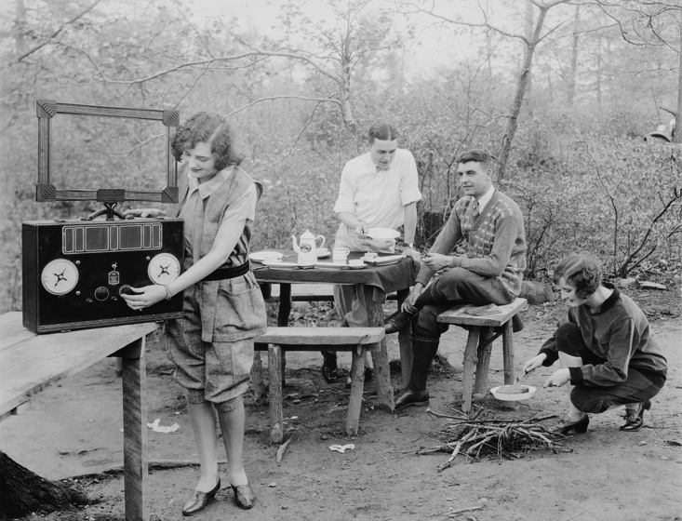
Dissemination initiated by us at Cochrane UK
Tweet?
Blogshot?
Weekly meeting to discuss
embargoed/published reviews
Blog?
Evidently Cochrane
S4BE
Relevance for UK?
Anne links with other reviews, guidelines etc
Suitable for a forthcoming campaign (4 per year)?
Does it fit any of our Everyday series?
Katie

Slide 20
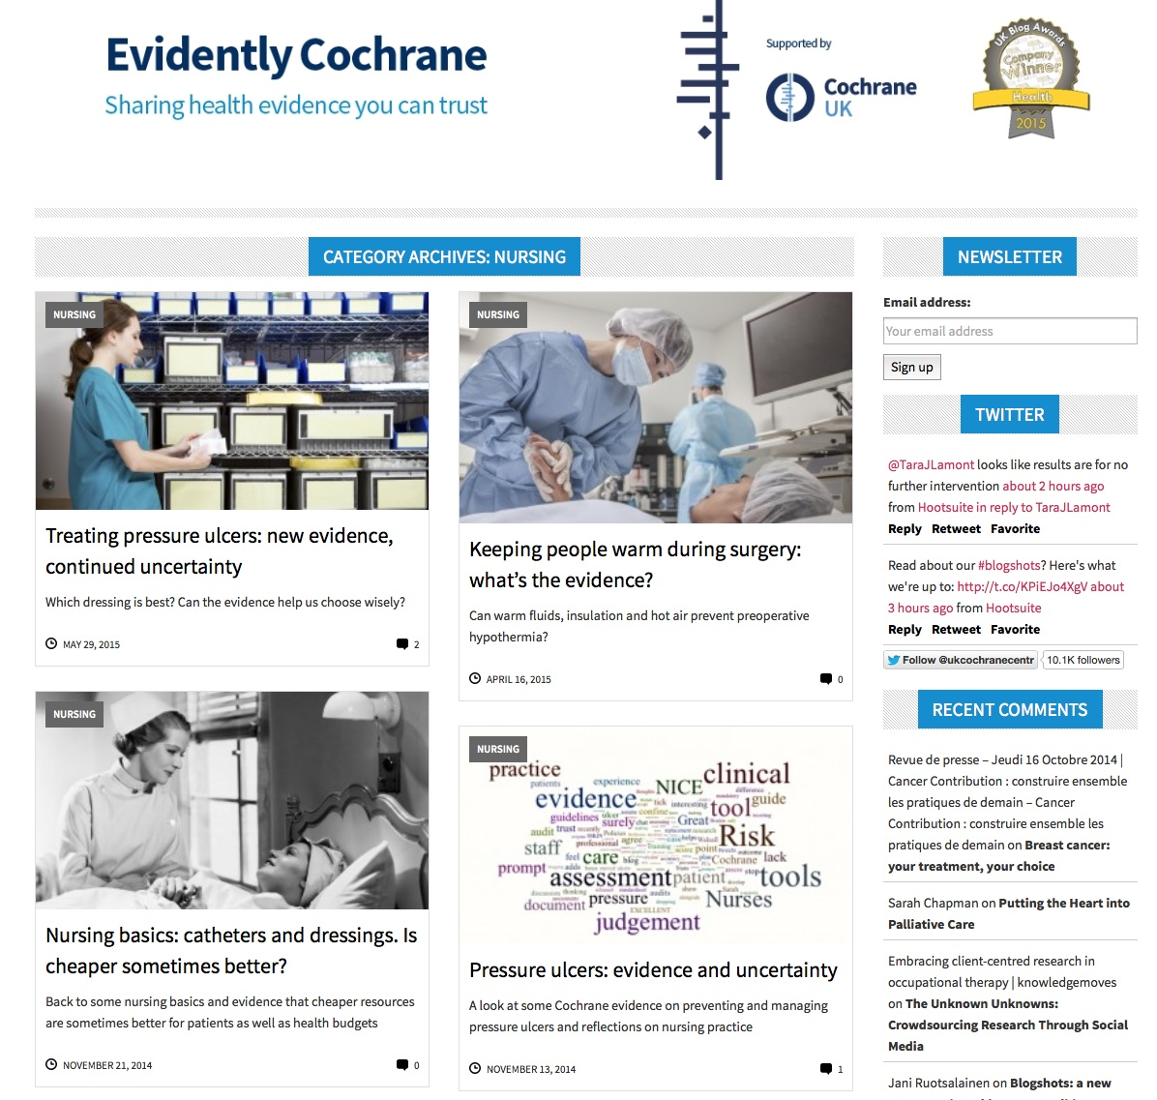
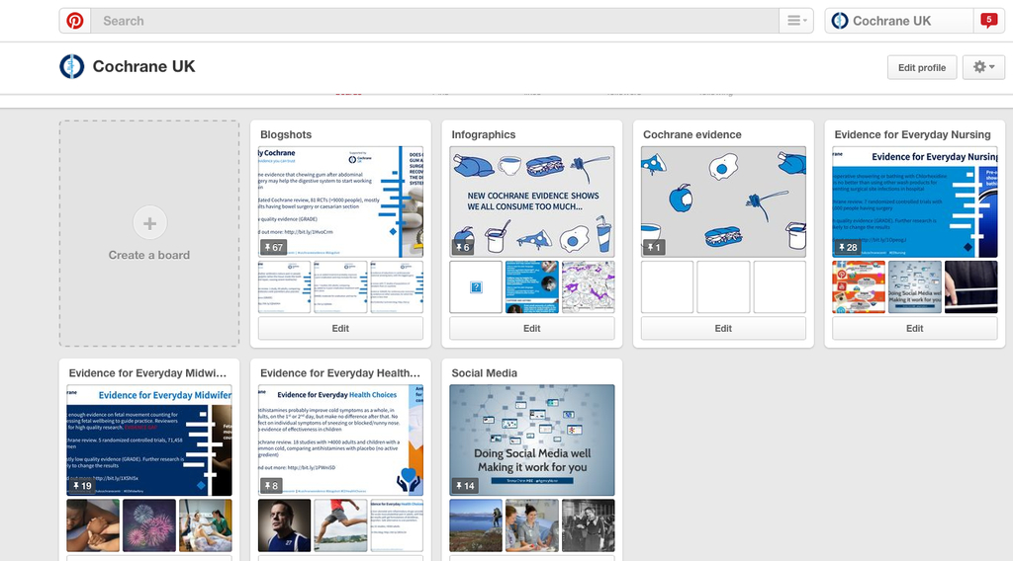
How we disseminate through social (& other) media
Pinterest
External partnerships
pins
Evidently Cochrane
blogshots
newsletters
blogs
S4BE
Journal articles
Cochrane UK website
(& other Cochrane sites)
Tweets (planned & responsive)
Facebook
tweetchats
tweets
LinkedIn

Slide 21
Evidence for Everyday series
#EENursing
#EEMidwifery
#EEHealthChoices
#EEAlliedHealth launching on 6th June
Why?
Targeted dissemination & content
Opportunity for partnerships e.g. The Practising Midwife, The RCN
What?
Blogs & blogshots
Tweetchats?
Articles?
What can you do?
Tell us about reviews that could fit
Help share our blogs/blogshots through your own dissemination channels

Slide 22
Blogshots
Shared on Twitter, Facebook, Pinterest and Cochrane UK website
Standard template plus adapted versions for each series
#EEHealthChoices template is different
We only use reviews that have SoF tables with GRADE
You can make your own! Download a blogshot template in your Group’s colour from the brand page under ‘Community Templates. Email to mumoquit@cochrane.org for sharing

Slide 23
When you spot a story, we might be able to help!
Lindsey suggested this topical item with relevant Cochrane evidence
I blogged it, rescheduling the planned blog
Alert & available on publication day
Mail journalist tweeted to ask to use the story

Slide 24
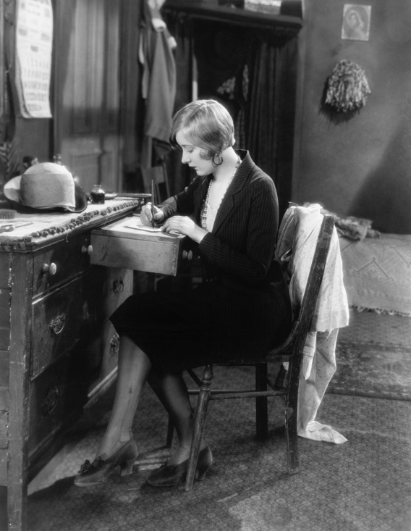
Let us know if we can help
(Just don’t phone!)

